Slide 1

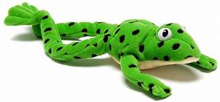
Phonics Screening Check
Parent Meeting
Thursday 22nd March 2018

Slide 2


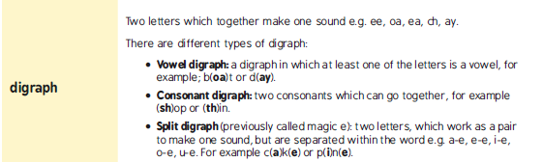


Phonics glossary
‘Special friends’
‘Fred talk’

Slide 3

What is the Phonics Screening Check?
http://www.ruthmiskin.com/en/resources/parent-tutorial-phonics-screening-check/

Slide 4
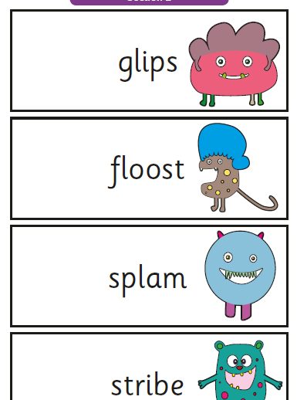
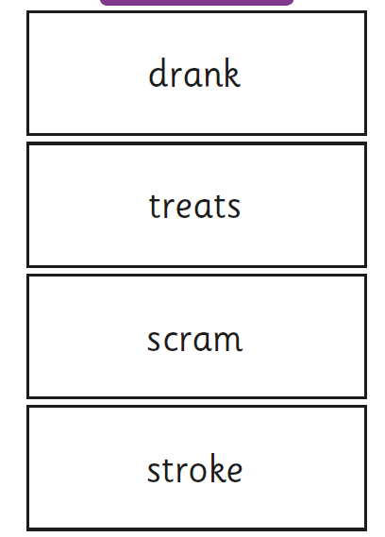
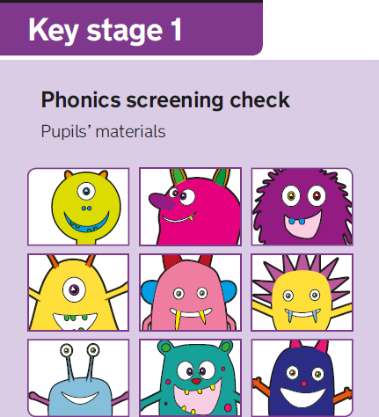
Previous papers and examples:

Slide 5
Important information
Date of Phonics Screening Check:
Monday 11th – Friday 15th June 2018
Who will administer the test: Miss Aston
Threshold mark released: Monday 25th June 2018 (previously 32 out of 40)
Letter confirming your child's results: July 2018

Slide 6
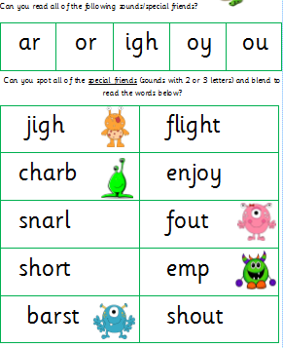
Preparation
At home:
Read, read & read some more
Encourage your child to spot any special friends, fred talk and then read the word
Complete phonics homework
Check reading targets and practise recognising particular sounds and reading words containing the sound
Refer to your speed sounds mat, in and out of order, so your child recognises all sounds confidently
In school:
Daily phonics lessons
Early bird phonics activities
Guided reading
Phonics activities in the classroom
Extra intervention where needed
Phonics homework – from next week!
Half termly phonics assessments

Slide 7
Resources
Speed sound mat (sent home)
Word cards to read at home (real and nonsense/alien)
http://www.ruthmiskin.com/en/parents/
https://www.youtube.com/channel/UCFqZcj-GHOdkMApIHrq_i7w
https://www.phonicsplay.co.uk/

Slide 8
Phonics Screening Mock
Results will be shared with you at parents evening
Highlight what sounds still need to be learned
Prepares children for the screening process

Slide 9
Sounds
Sound pronunciation video:
http://www.ruthmiskin.com/en/resources/sound-pronunciation-guide/
Possible sounds included in screening:
https://www.gov.uk/government/uploads/system/uploads/attachment_data/file/628842/Y1_Phonics_assessment_framework_PDFA_V3.pdf pages 12 - 14
Alternative pronunciations:
e.g. ‘e as in bed, dead, we ’ or ‘ea as in bead, head’ or ‘ch as in chip, chef, school’ - same grapheme, different sound!

Slide 10
Phonics in action:
https://www.youtube.com/watch?v=3QCC6MsIxd8&t=2s

Slide 11
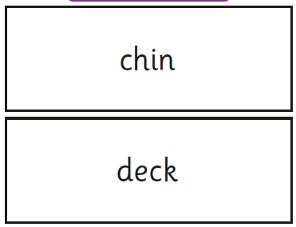
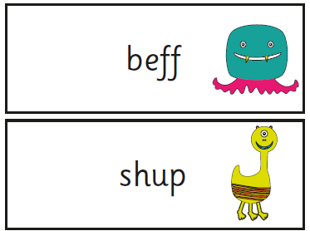
Let’s have a go…
Spot any ‘special friends’
Fred talk it
Read the word
What a load of nonsense!

Slide 12
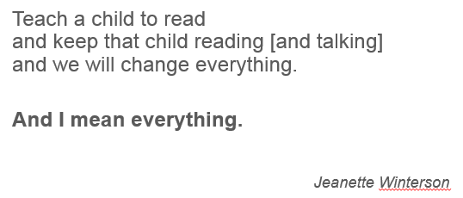
Thank you for your time ☺
Any questions please speak to Miss Aston or your child’s class teacher.
Keep practising and supporting your child's phonics and reading journey at home!

