Slide 1
Support for parents and guardians

Slide 2
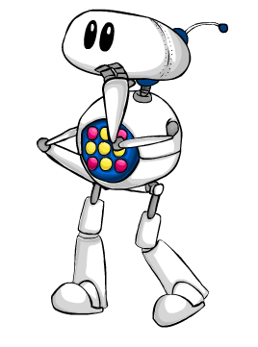
What is MyMaths?

Slide 3
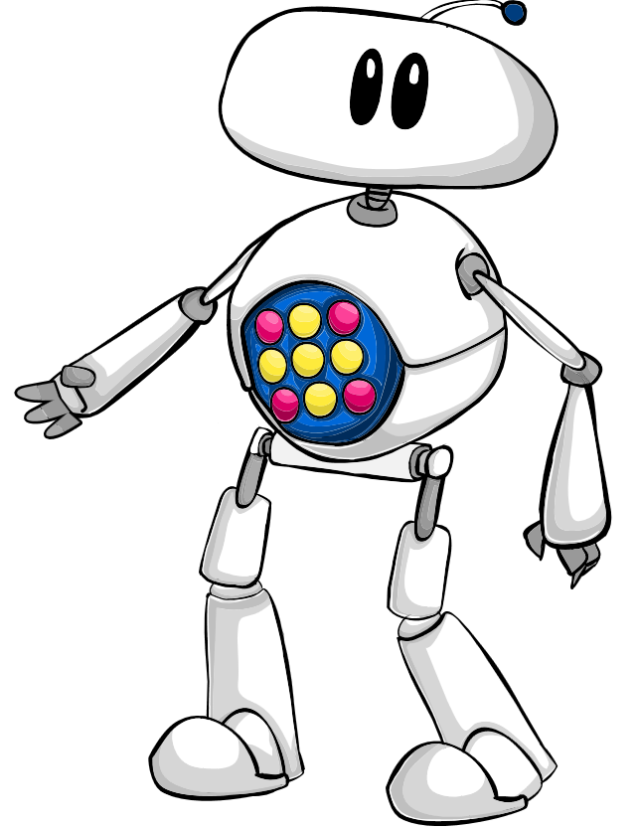
What is MyMaths?
MyMaths is a website subscription for teaching and learning maths, from Oxford University Press.
It is written by experienced maths teachers to meet the demands of the UK curricula.
MyMaths includes:
hundreds of homework activities
a lesson to match each homework
revision ‘booster packs’
a record of all your child's scores so you can track their progress
lots of fun maths games

Slide 4
What will my child be asked to do on MyMaths?

Slide 5
What will your child be asked to do?
Your child’s school may use MyMaths during class time, and for setting your child’s maths homework.
The activities that your child is likely to work on at home are:
homework activities
online “worksheets”
This guide will take you through how to access and complete these activities so that you can confidently help your child with their maths homework.

Slide 6
How do we access MyMaths at home?

Slide 7
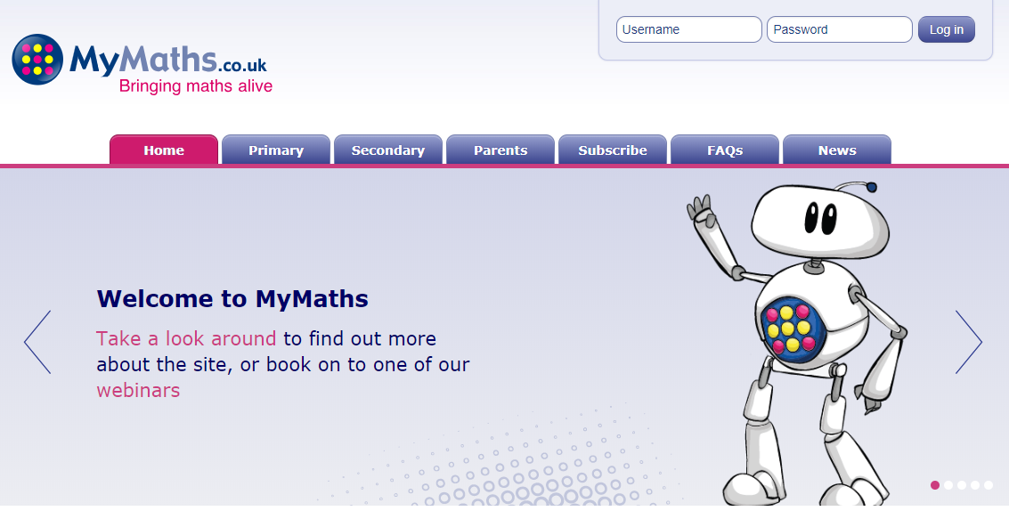
How do you log in to MyMaths?
Go to www.mymaths.co.uk which will bring you to the below web page.
This is where you enter the school’s log in details, provided by your child’s teacher.

Slide 8
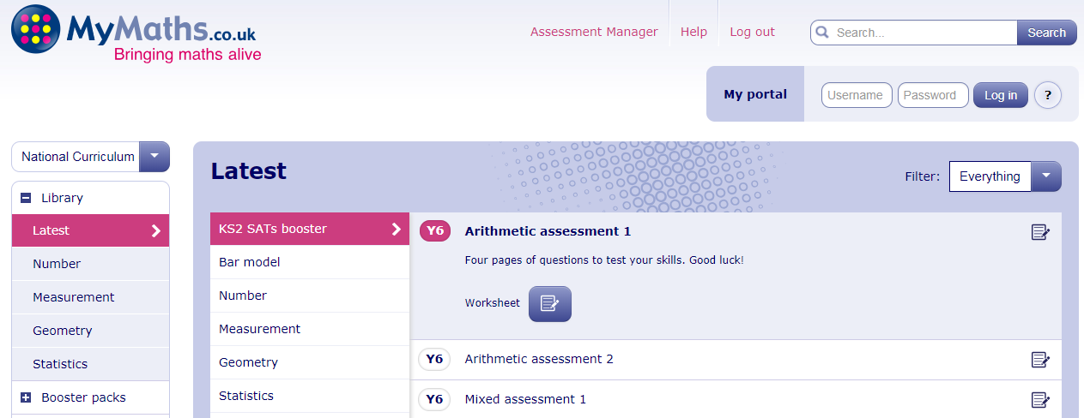
How do you log in to MyMaths?
After entering the school log in details, you will be taken to the MyMaths Library.
To access the work that your child’s teacher has set for them, enter your child’s personal log in details in the ‘My portal’ section.

Slide 9
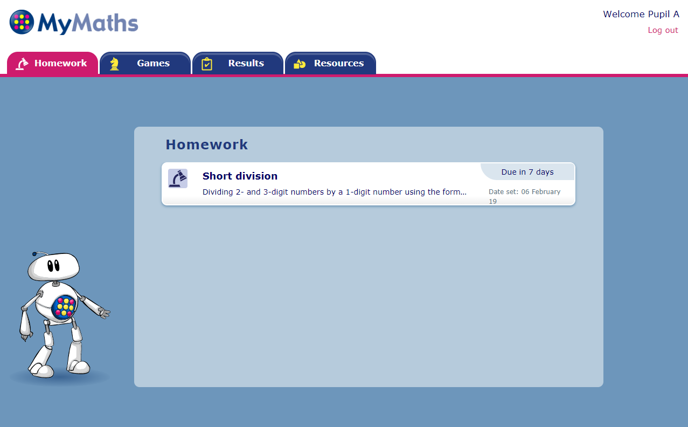
How do you log in to MyMaths?
In your child's portal, they can access any homework that their teacher has set for them.

Slide 10
How do we find our way around a MyMaths homework activity?

Slide 11
Finding your way around MyMaths homework
When you click on a homework activity, a pop up will appear. Click the ‘Start homework’ button.

Slide 12
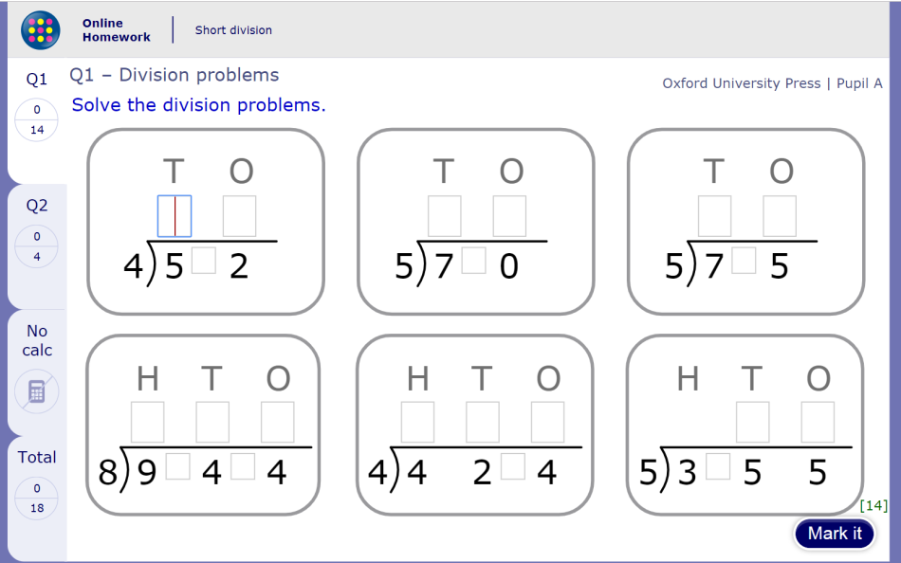
Finding your way around MyMaths homework
Homework activities have two pages of questions.
Q1 contains straightforward questions to ease children into the topic and build their confidence.

Slide 13
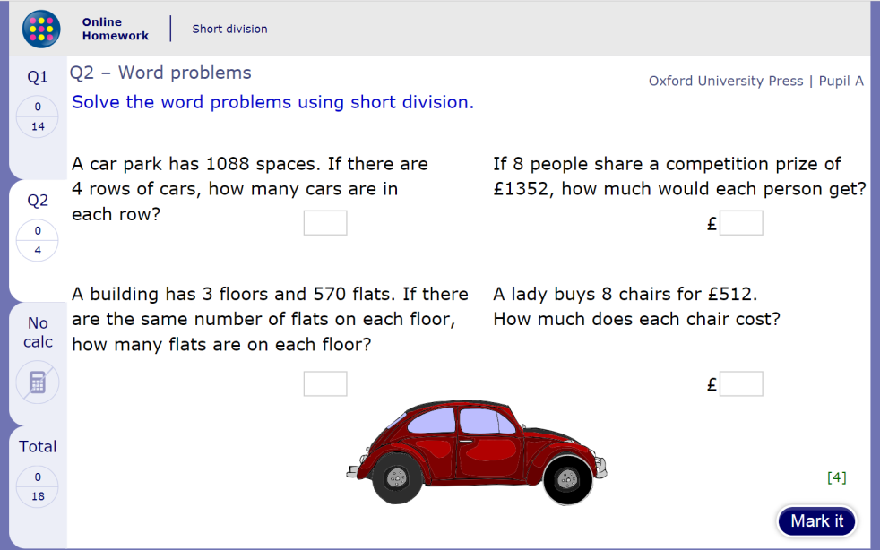
Finding your way around MyMaths homework
Q2 contains slightly more complex questions to encourage your child’s progression. They may find it helpful to have paper to hand for working out their answers.

Slide 14
Finding your way around MyMaths homework
On each page, once your child has completely finished entering their answers, they should click the ‘Mark it’ button.
This will mark and save their answers for each page.

Slide 15
Finding your way around MyMaths homework
Once the ‘Mark it’ button is clicked, correct answers will receive a green tick and, where appropriate, incorrect answers will have the correct answer displayed underneath.

Slide 16
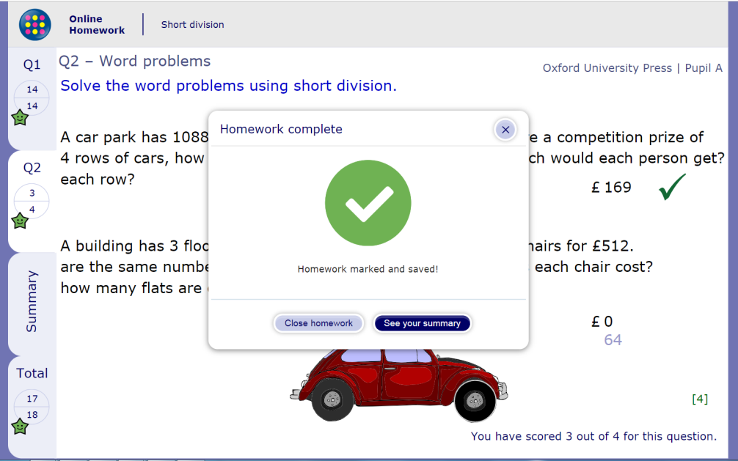
Finding your way around MyMaths homework
Once they have clicked ‘Mark it’ on both pages of the homework activity, their homework will be marked and saved.
Their teacher will be able to see their results right away.

Slide 17
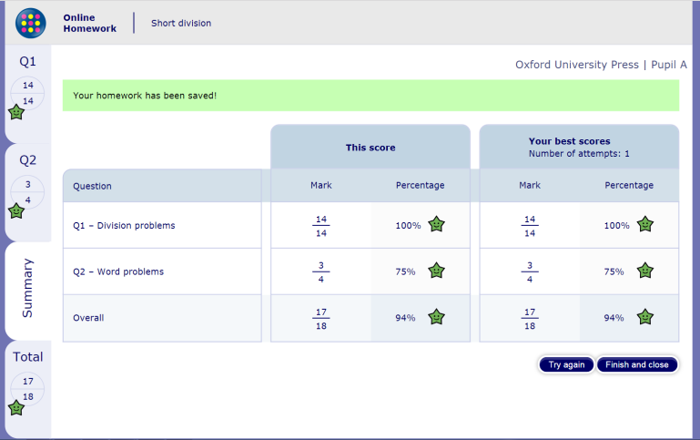
Finding your way around MyMaths homework
Your child can go to the Summary tab to see how they scored. Their most recent attempt is displayed under ‘This score’.
In case they attempt the homework more than once, their highest overall score is shown as ‘Your best scores’.

Slide 18
How can I help my child with their MyMaths homework?

Slide 19
How can you help with homework?
If your child is struggling with their homework, or would like to recap the topic before they have a go, encourage them to click on the ‘Need practice?’ button.

Slide 20
How can you help with homework?
This will open a lesson which is specifically designed to help them learn and master the skills needed in the homework.
Lessons include step-by-step examples and lots of opportunities to practise skills without marks being saved.

Slide 21
How can you help with homework?
The way maths is taught, and the vocabulary used, has changed over the years.
MyMaths lessons can help you to support your child by explaining concepts such as partitioning, base 10, exchanging and bar modelling.

Slide 22
What is a MyMaths worksheet and how is it different to a homework activity?

Slide 23
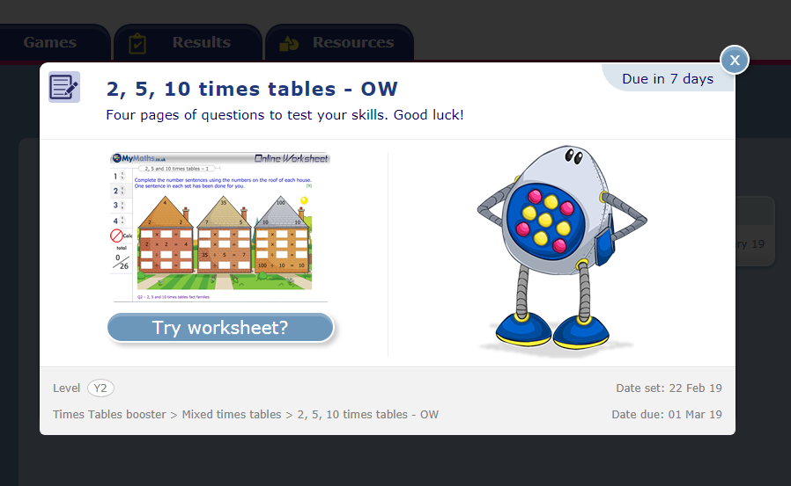
What is a worksheet?
The other type of activity your child may be set is a worksheet.
Worksheets are part of our Booster Packs. The Booster Packs are collections of resources with a particular aim, such as brushing up on times tables, or preparing for SATs.

Slide 24
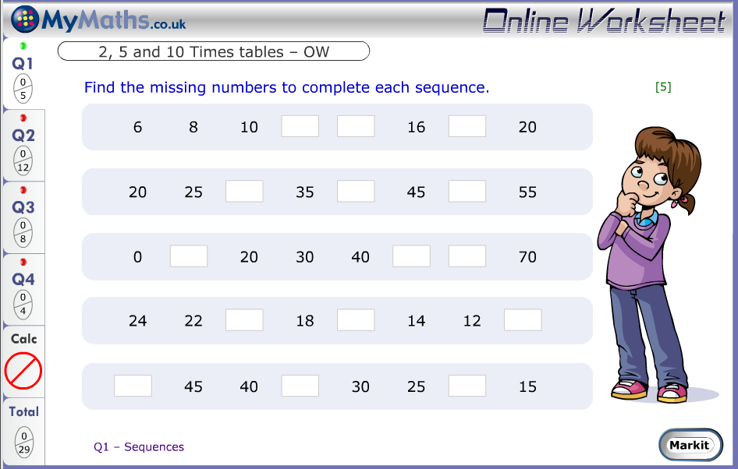
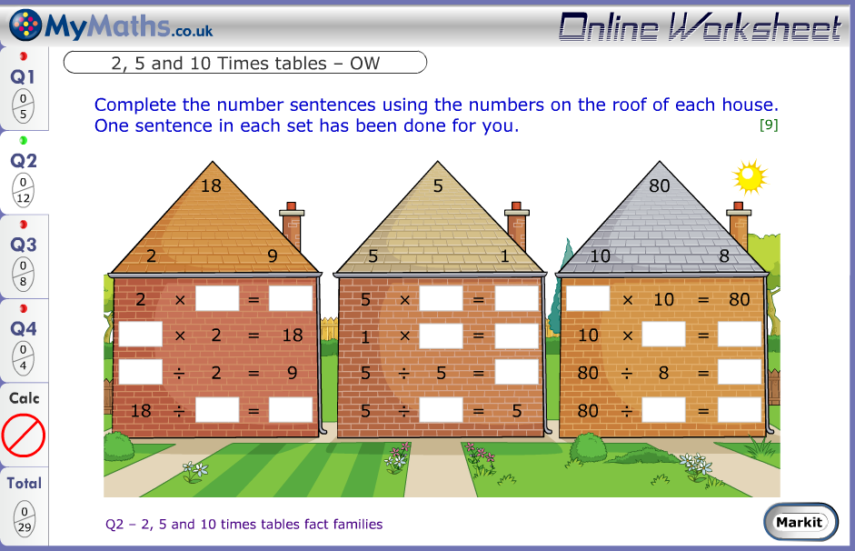
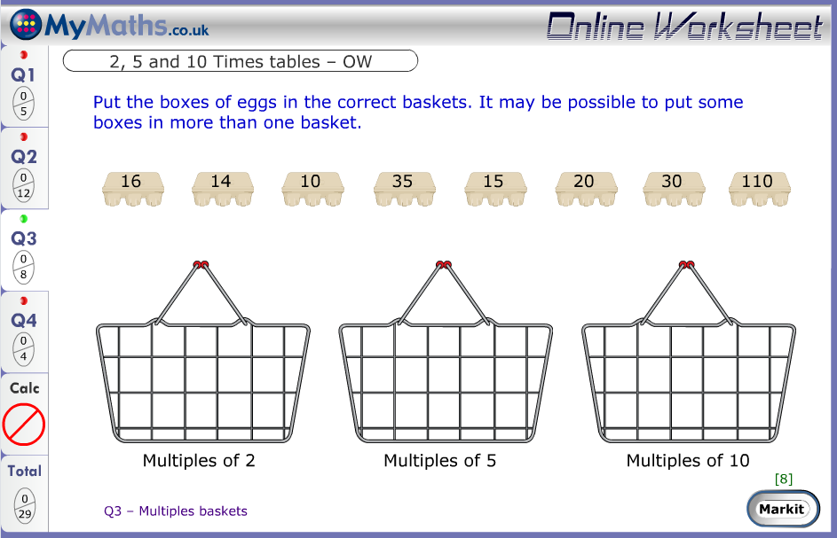
What is a worksheet?
Each Booster worksheet contains 4 pages of questions that allow children to check their knowledge in a particular area.

Slide 25
Where are the games?

Slide 26
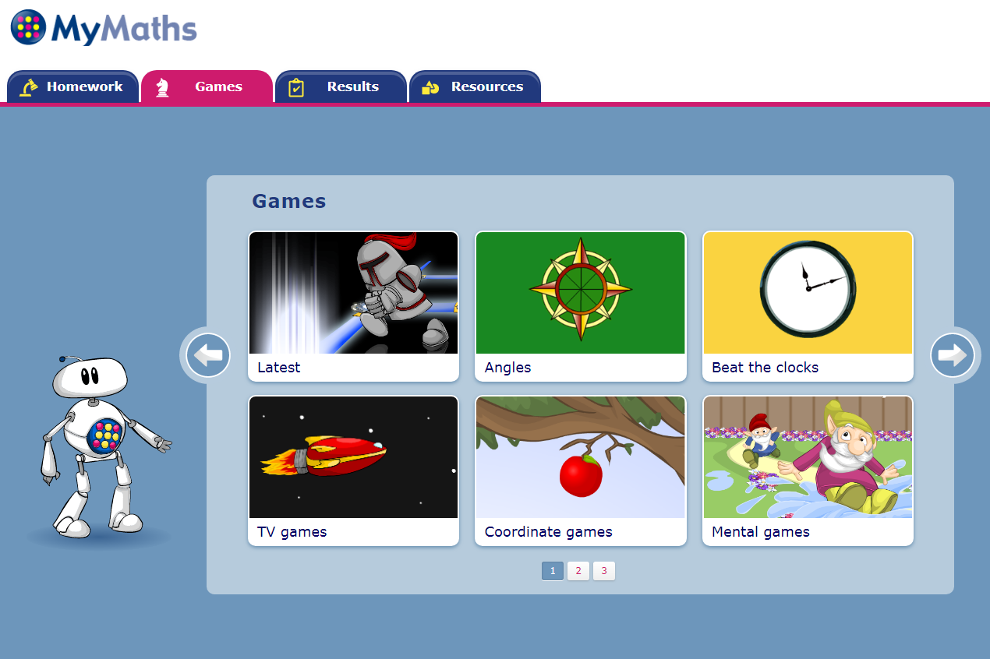
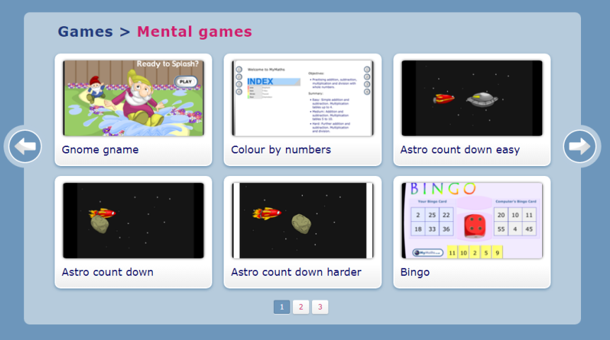
Where are the games?
In the Games tab you can find a variety of maths games that target particular maths skills, for instance mental maths.
Clicking on one of the tiles will show the games in that section.

Slide 27
How can I check my child’s MyMaths progress?

Slide 28
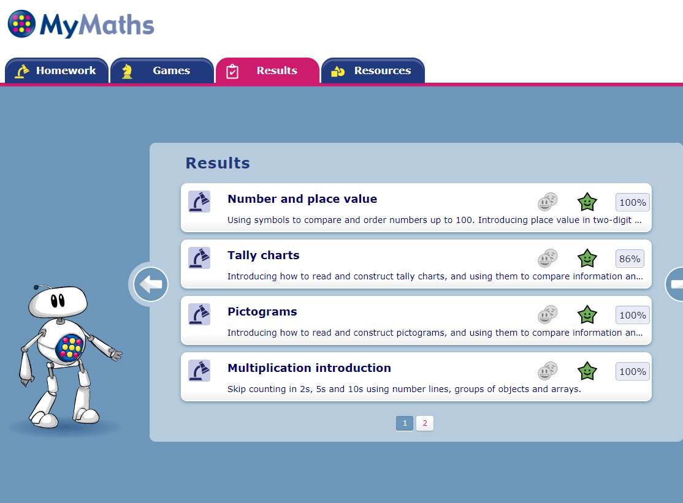
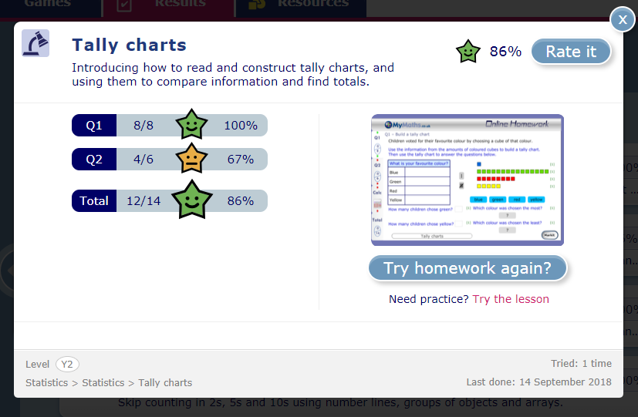
How can you check your child’s progress?
In the Results tab of the pupil portal you’ll see a list of the tasks your child has completed, along with their scores.
Clicking on one of the items in the list will give you more details.

Slide 29
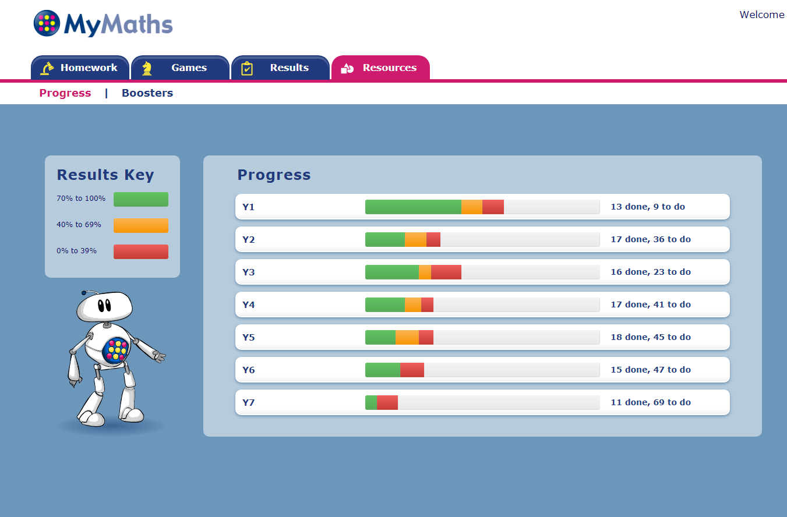
How can you check your child’s progress?
In the ‘Progress’ section of the Resources tab, you can see how many of the available homework tasks your child has completed, and how they scored.
You can click here to see a list of the completed or still-to-do homework activities.

Slide 30
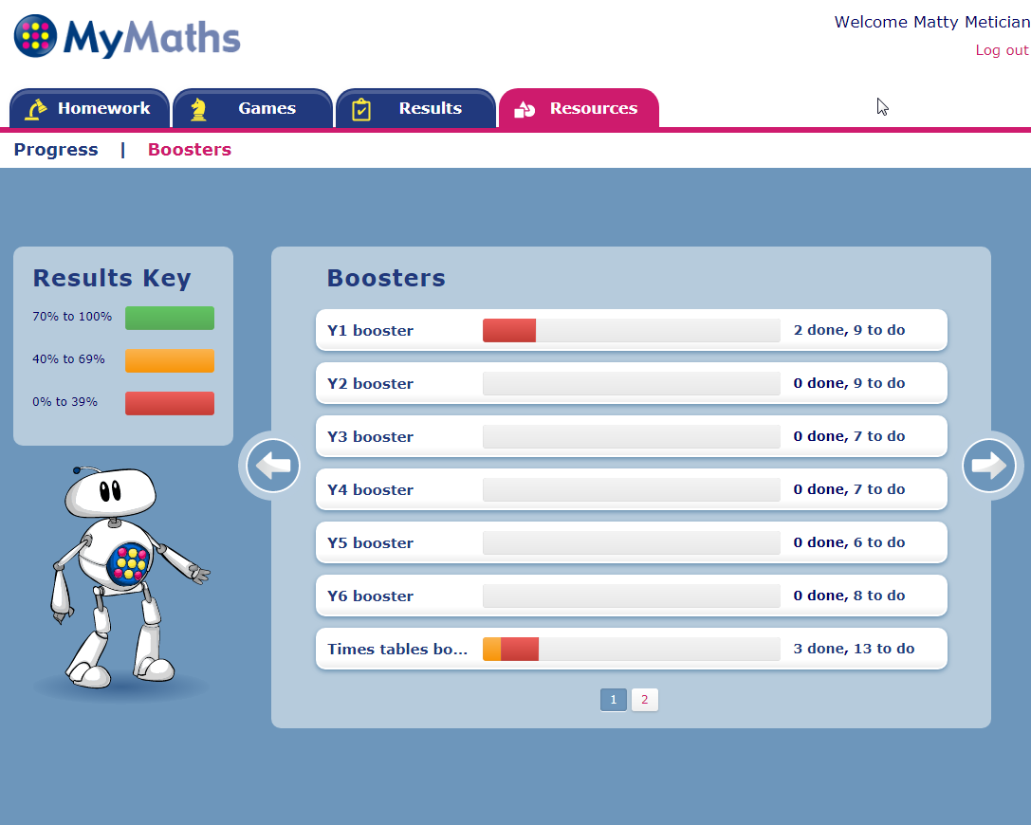
How can you check your child’s progress?
Similarly, in the ‘Boosters’ section of the Resources tab, you can see how many of the available worksheets your child has completed, and how they scored.
You can click here to see a list of the completed or still-to-do worksheet activities.

Slide 31
Why has my child been set a task from a different year group?

Slide 32
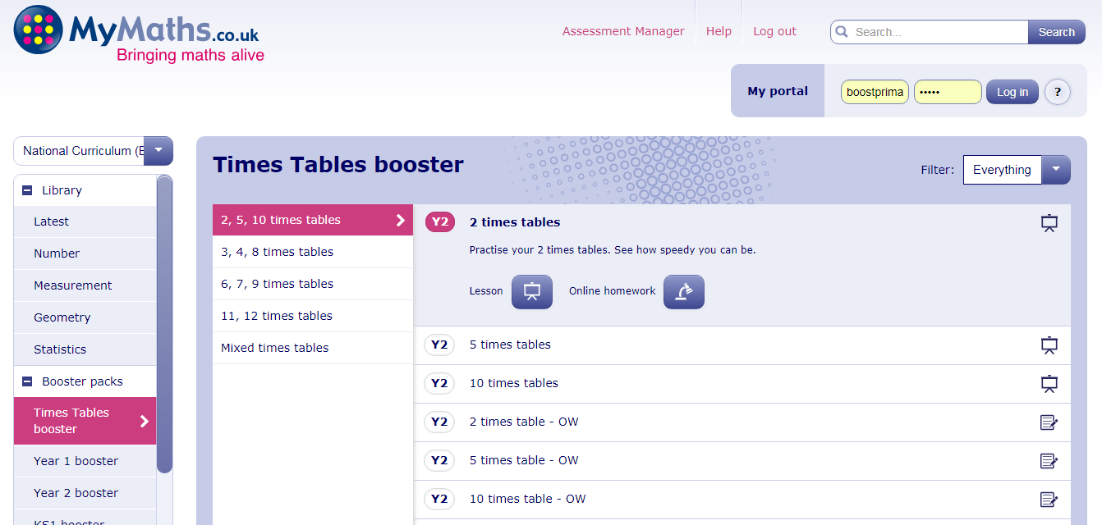
Why has my child been set another year’s task?
To help teachers find suitable content, all of our content is tagged with a particular level or year group.
This does not mean it is not suitable for older children.
For example, the 2, 5 and 10 times table worksheets are labelled Year 2, but will be useful for children the whole way through primary school to keep their skills topped up.

Slide 33
Need help with technical set up?

Slide 34
A note on Adobe Flash player
Some internet browsers have stopped supporting Flash by default. This means some MyMaths content may be blocked by your browser.
Please follow this link to view a step-by-step guide on enabling Flash:
https://helpx.adobe.com/flash-player.html
Please note that the MyMaths team are working hard to convert all our content out of Flash as soon as possible, and we update the site all the time!

Slide 35
How do you access MyMaths on a tablet?
If you are accessing MyMaths via an iPad or Android tablet, you will need to download the Puffin Academy app for free from the Google Play Store or from the Apple App Store.
Please follow the below link to view our video tutorial on how to set this up:
https://www.youtube.com/watch?v=ygAq0oTEwBI

Slide 36
For further support and feedback
For additional support and technical information:
Visit the MyMaths support site:
https://global.oup.com/education/product_support/mymaths/?region=uk
Watch walkthrough and instructional videos on YouTube:
https://www.youtube.com/watch?v=N-XR7tYIjEA&list=PLW-Dpen99Aj6q7kw926mAwj9lMyuk5Tfu
If you have any questions or feedback, contact the Customer Services team:
Telephone: +44(0) 1536 452970
Email: mail@mymaths.co.uk

